Slide 1


Transforming Water Access: A Data-Driven Approach
Maji Ndogo is a community-driven initiative that leverages the power of SQL to uncover insights and drive sustainable water usage. This presentation will delve into the data collection, analysis, and reporting processes that have enabled Maji Ndogo to impact water conservation efforts.
by Beverly Boyani

Slide 2

Data Exploration and Cleaning
1
Structured Database
2
Revealing Insights
Cleaned and organized a 60,000-record database, ensuring data integrity and quality.
Uncovered hidden patterns and trends within the data through comprehensive exploration.
3
Laying the Foundation
Prepared the data for advanced analytics, setting the stage for impactful decision-making.

Slide 3

SQL Query Techniques
Aggregation
Filtering
Using SQL functions like SUM, AVG, and COUNT to gain insights into overall water usage patterns.
Applying WHERE clauses to isolate data based on specific criteria, such as location or time periods.
Joins
Time-Series Analysis
Combining data from multiple tables to uncover relationships and identify correlations.
Leveraging SQL date and time functions to analyze trends and seasonal variations in water usage.

Slide 4
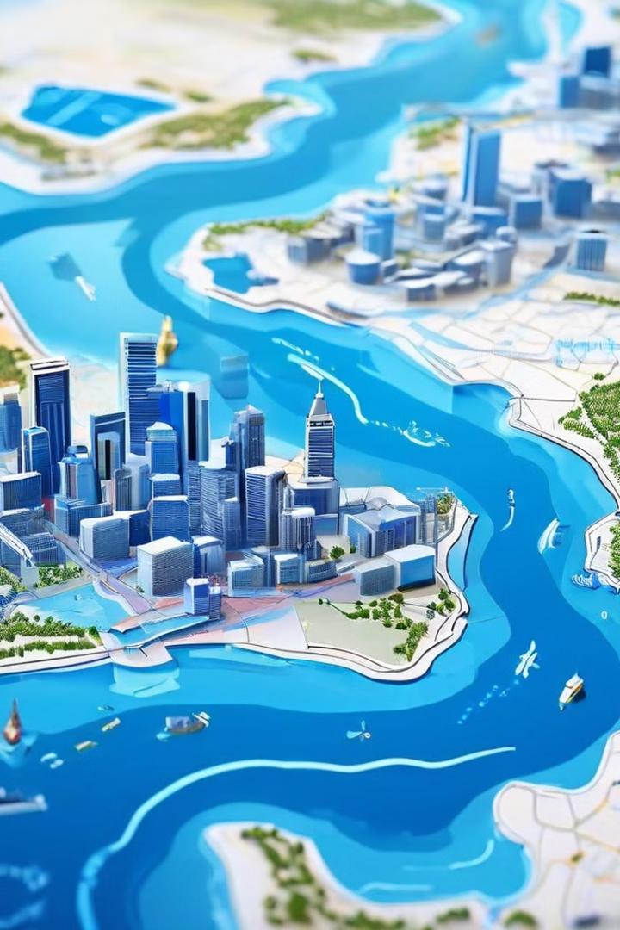
Infrastructure Gap Identification
1
Data Integration
Integrated diverse data sources, including census, water utility, and geographic information.
2
Comprehensive Audit
Conducted a thorough audit of the existing water infrastructure and access points.
3
Gap Identification
Pinpointed areas with inadequate or unreliable water infrastructure, informing targeted interventions.

Slide 5
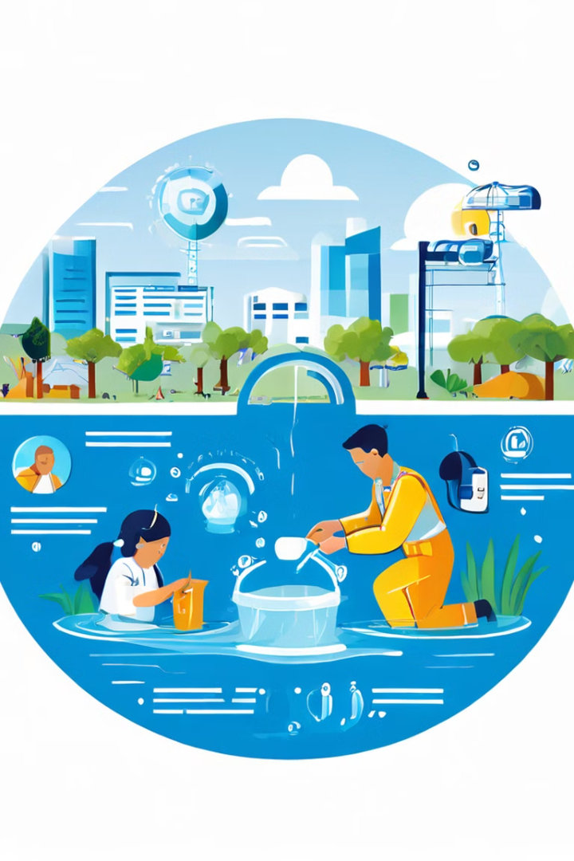
Roadmap for Sustainable Solutions
Stakeholder Engagement
Prioritized Interventions
Developed a strategic roadmap outlining phased improvements to water infrastructure and access.
Collaborated with local communities and authorities to incorporate their needs and perspectives.
Measurable Outcomes
Scalable Approach
Defined key performance indicators to track the progress and impact of the implemented solutions.
Designed the roadmap to be adaptable and replicable in other underserved communities.

Slide 6




Empowering Communities
Community Engagement
Fostering active participation and ownership among local stakeholders.
Educational Initiatives
Implementing programs to increase water literacy and conservation awareness.
Sustainable Solutions
Designing water infrastructure and access improvements with long-term sustainability in mind.

Slide 7
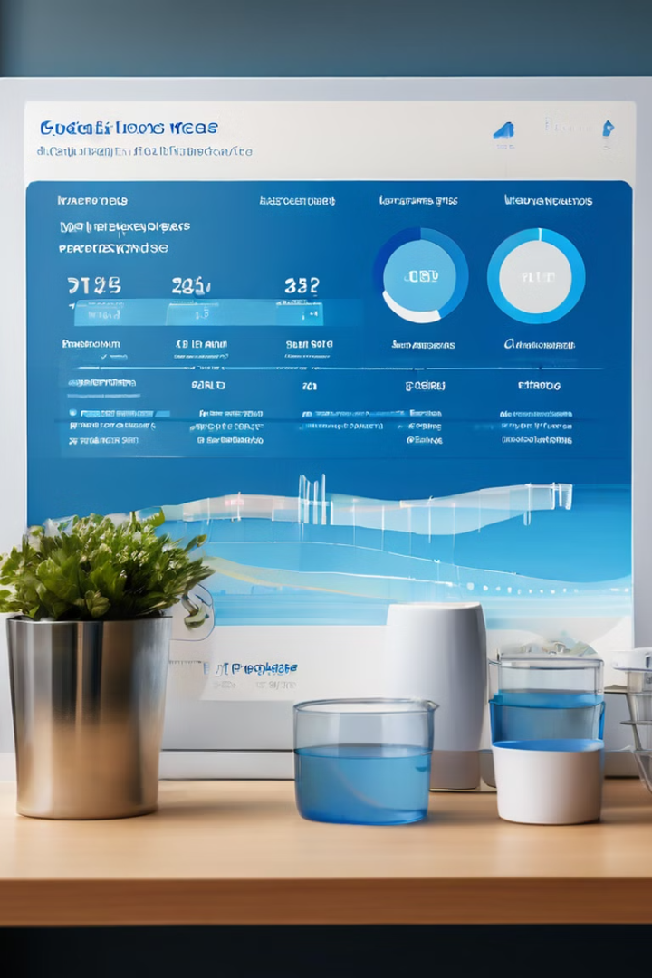



Driving Measurable Impact
Data-Driven Decisions
Leveraging the insights gained to guide the implementation of effective interventions.
Iterative Improvements
Continuously monitoring and adjusting the roadmap to maximize the impact.
Scalable Approach
Sharing the successful model to replicate the impact in other underserved communities.

Slide 8
Transforming Lives Through Sustainable Water Access
Improved Quality of Life
Economic Opportunities
Environmental Stewardship
Ensuring reliable and equitable access to clean water, enhancing community well-being.
Unlocking new economic possibilities through sustainable water infrastructure development.
Promoting water conservation and responsible resource management for long-term sustainability.

